Slide 1

POWER BI PROJECT
BANK LOAN DEFAULT RISK DASHBOARD
Summer Training — Power BI | [Chandigarh Engineering College]
Presented by
Course
Guided by
Date
Anuj Chauhan | 2420671
B.Tech (AI/DS)
Dr Ashima
06-07-2026

Slide 2
Agenda
01
Problem Statement & Objective
05
Dashboard Walkthrough
02
Dataset Overview
06
Key Insights & Findings
03
Power Query — Cleaning Steps
07
Publishing to Power BI Service
04
DAX Measures
08
Conclusion & Q&A
2 / 14

Slide 3
01 Problem Statement
Banks need to identify high-risk borrowers to reduce loan defaults and improve lending decisions.
3 / 14

Slide 4
Problem Statement & Objectives
The Problem
Target User
The risk management team needs an interactive dashboard to monitor loan default risk across different loan grades, income bands, and loan purposes. The objective is to identify high-risk segments, track default rates, and support data-driven lending decisions using key risk metrics and visual analytics.
Risk Management Team
Credit Risk Analysts
Loan Portfolio Managers
Senior Management / Decision Makers
Project Objectives
Analyze loan default rates across different loan grades, income bands, and loan purposes.
Calculate and monitor key risk metrics using DAX measures such as total loans, default count, and default rate.
Identify high-risk customer segments to support proactive risk management
Support data-driven lending decisions by providing clear visual insights into loan performance and default trends
Develop an interactive Power BI dashboard for real-time loan portfolio analysis.
4 / 14

Slide 5
Dataset Overview
Kaggle
CSV
1,55,456
145
Source
File Type
Rows
Columns
The original dataset contained 155,456 rows and 145 columns. To improve processing efficiency and focus on relevant analysis, a sampling technique was applied to randomly select 30,000 records. The sampled dataset was then cleaned and preprocessed using Python (Pandas), resulting in a final dataset of 30,000 rows and 17 columns used for this project.
6 / 14

Slide 6
02 Dataset Overview
Source, structure, and key fields
5 / 14

Slide 7
Key Columns Used
Data Quality Steps
Reduced dataset from 155,456 rows & 145 columns to 30,000 rows & 17 columns
Removed unnecessary columns
Filtered and retained only relevant records
Handled missing (null) values
Corrected data types (Text, Number)
Created Income_Band column
Created Default_Status column for loan classification Renamed columns for better readability
Column Name | Role in Dashboard
Loan_Amount | Loan value analysis
Funded_Amount | Amount funded by lender
Term | Loan duration (36/60 months)
Int_Rate | Interest rate analysis
Grade | Credit risk segmentation
Annual_Income | Borrower income analysis
Purpose | Loan purpose analysis
Home_Ownership | Borrower housing status
Employment_Length | Employment analysis
DTI | Debt-to-Income (DTI) ratio analysis
Loan_Status | Default vs Fully Paid analysis
Income_Band | Borrower income band categorization

Slide 8
04 Dashboard Walkthrough
Pages, visuals, and interactivity
11 / 14

Slide 9
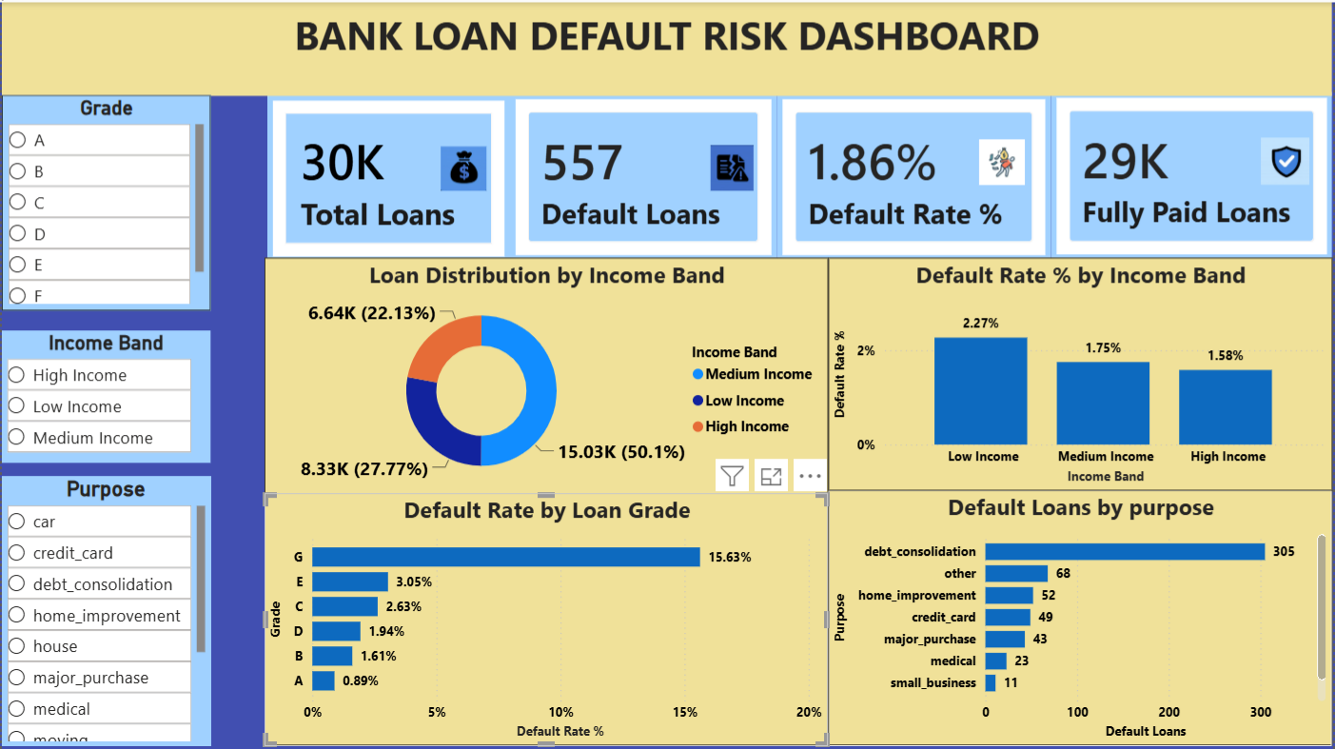
Dashboard : Overview
Visuals on this page
KPI Cards – Total Loans, Default Loans, Default Rate %, Fully Paid Loans
Clustered Bar Chart — Default Rate by Loan Grade , Default Loans by Purpose
Donut Chart — Loan Distribution by Income Band
[ Screenshot — Overview Page ]
Clustered Column Chart— Default Rate% by Income Band
Slicer — Grade,Income Band,Purpose
Key Insight
Low-income borrowers and lower loan grades show the highest default risk
12 / 14

Slide 10
Key Findings & Insights
Most loans are fully paid, with a default rate of only 1.86%
Debt consolidation is the leading purpose of defaulted loans.
01
04
Low-income borrowers have the highest loan default rate
Income level, loan grade, and loan purpose are the key factors influencing loan default risk
02
05
Grade G loans show the highest default risk among all loan grades
03
13 / 14

Slide 11
Conclusion & Thank You
Successfully built a Loan Default Risk Dashboard using Power Bi
Identified high-risk borrowers based on income,loan grade,and loan purpose
Created interactive dashboards using DAX measures , charts and slicers
Future scope: Add machine learning to predict loan defaults more accurately
Questions & Feedback Welcome
14 / 14

